Slide 1
Festive Gathering 2017
Development Session

Slide 2
Session Aims
Networking
Opportunity to hear and share recent achievements from across sector
Reflection on how we celebrate and promote key successes

Slide 3
The varied member institutions of SSS face very different challenges but are bound together by a common purpose and a desire to move forward as one.
SSS will harness the expertise of members and partners to inform development and fuel progress, whilst maintaining excellent value for money and fostering positive collaboration.
Notes:
Bringing the strategy to life.
This afternoon’s session has a clear focus on networking and learning from others. This aligns with SSS’ new strategy, in particular our commitment to work collaboratively.

Slide 4
“Alone we can do so little; together we can do so much.”
Helen Keller
Notes:
Some afternoon inspiration!

Slide 5
Over to you!
Task 1
Introduce yourself to someone in your group whom you have never met before and take it in turns to find out one tangible thing you do in your job to promote inclusion in sport.

Slide 6
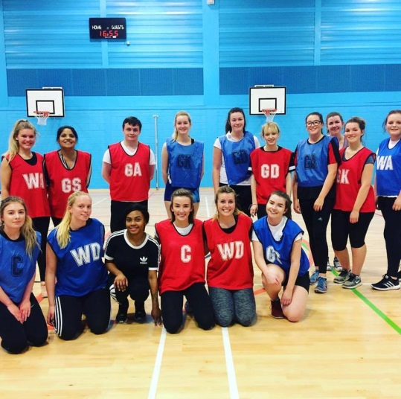
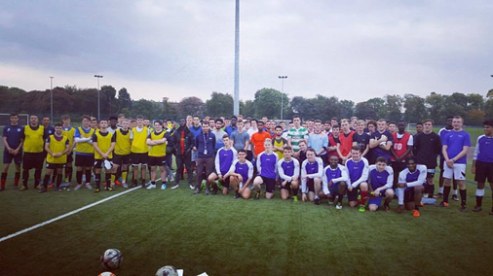
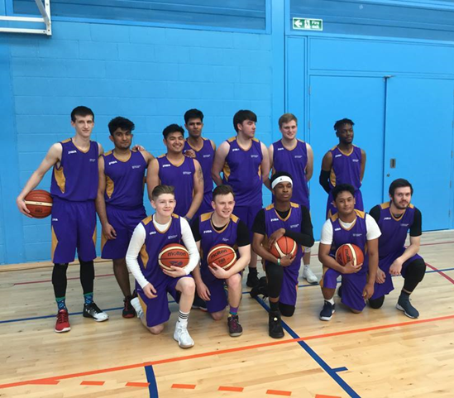
Andrew Kirk, City of Glasgow College Sports Coordinator

Slide 7
Achievements and challenges across the sector
Task 2
Share recent achievements you have had at your institution. What has been the impact of these achievements? Each group will relate their achievements to a SSS Strategy value as follows:
Group 1: Ambitious Group 4: Responsive
Group 2: Inclusive Group 5: Collaborative
Group 3: Innovative

Slide 8
Celebrating Success
Task 3
Reflect on what you have done to celebrate and publicise your key successes. Why is this important? How else can you promote key successes?
Task 4
Note down three actions relating to celebrating success following 24 / 7 / 31 rule.

Slide 9
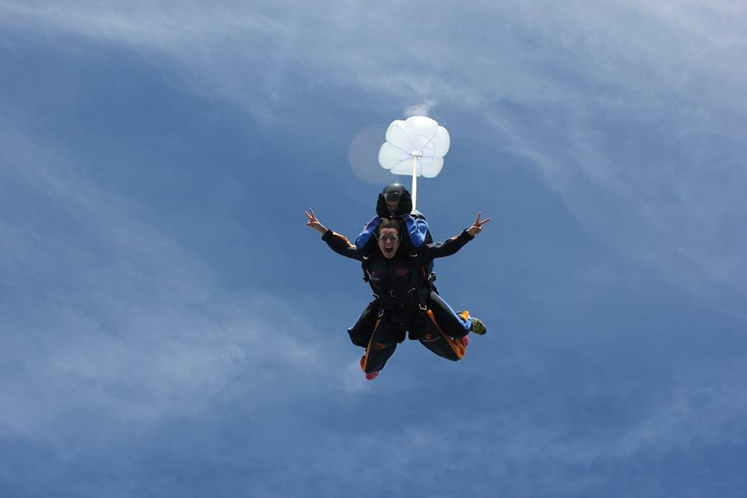
Takeaways…

Slide 10
Thank You
Notes:
Summarise importance of networking and collaborative working
For any further information on what has been discussed this afternoon, get in touch

